Slide 1
2016 MCFA Online Entries Step by Step

Slide 2
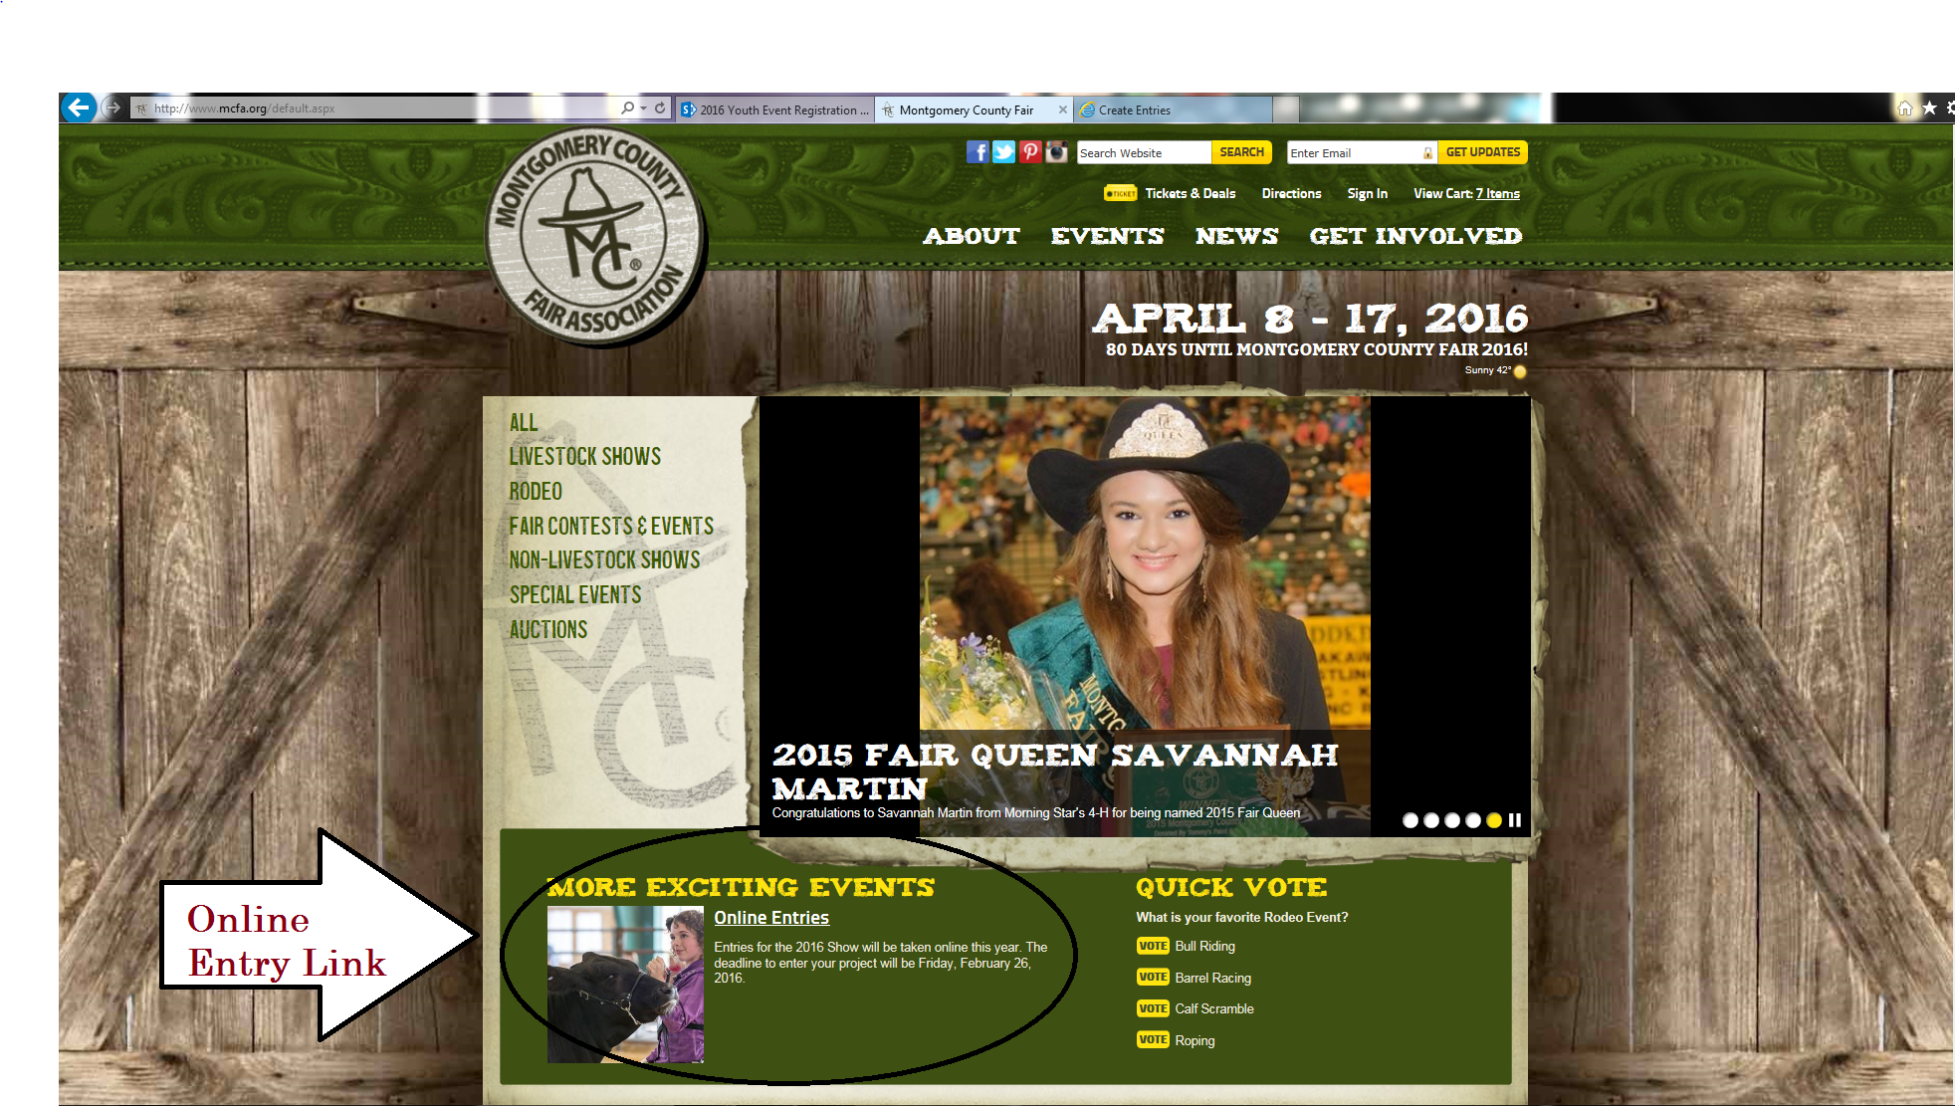

Slide 3
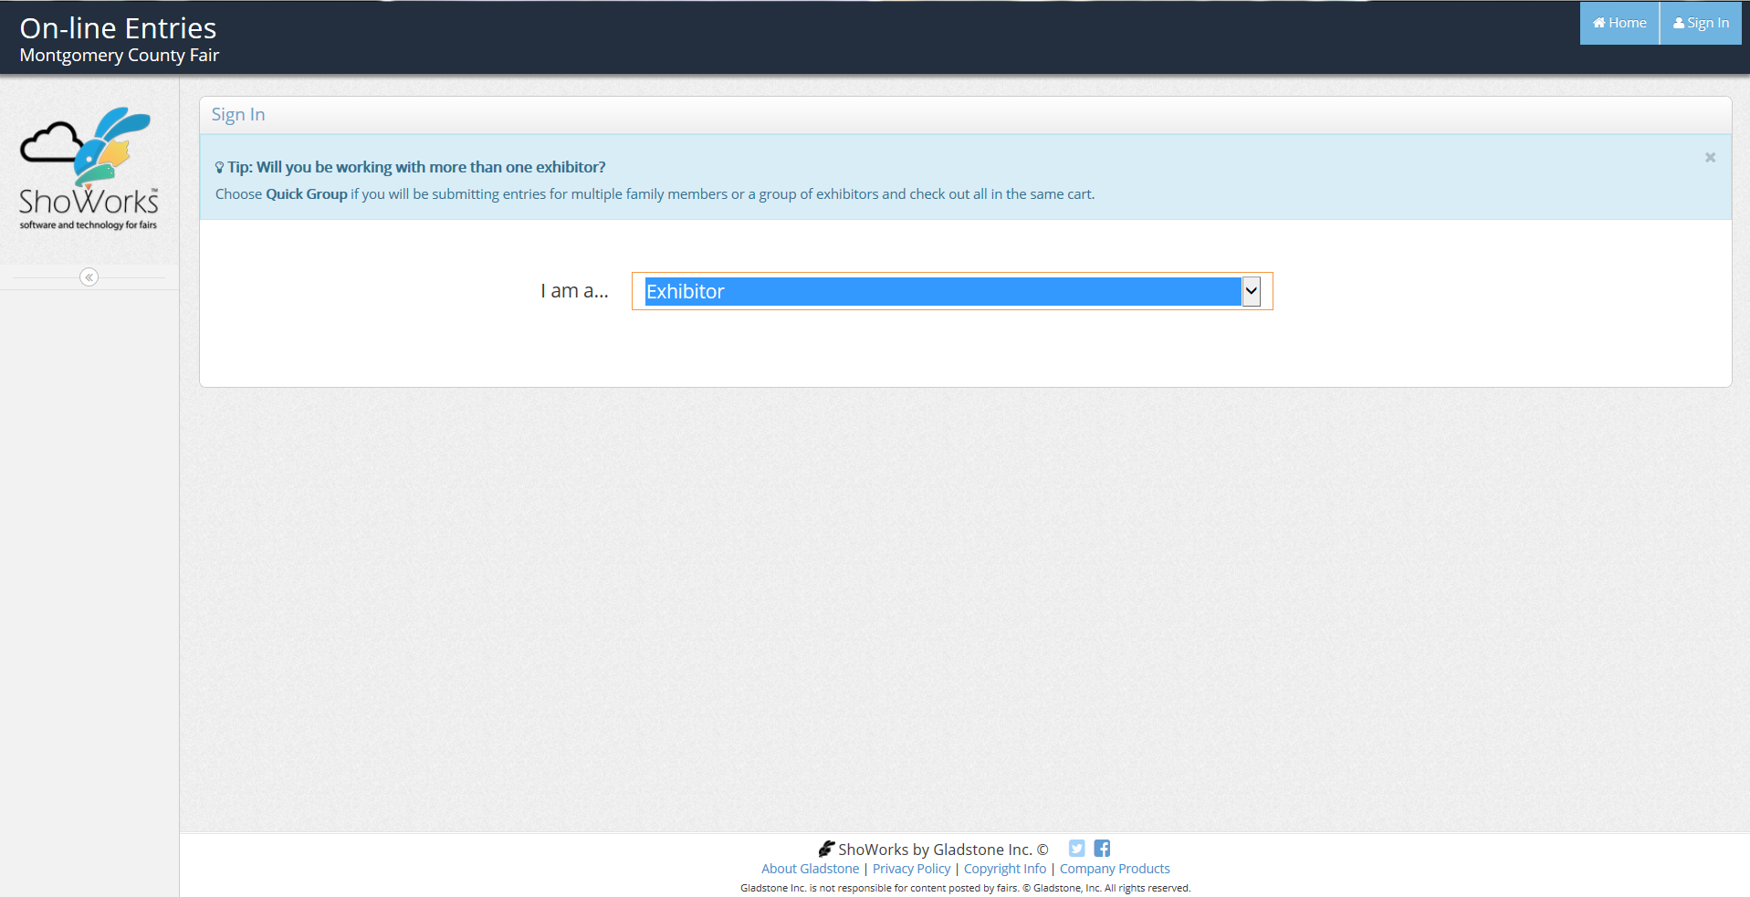
Title and Content Layout with List
Add your first bullet point here
Add your second bullet point here
Add your third bullet point here
An Exhibitor is a single person entry
A Quick Group is a family entering

Slide 4
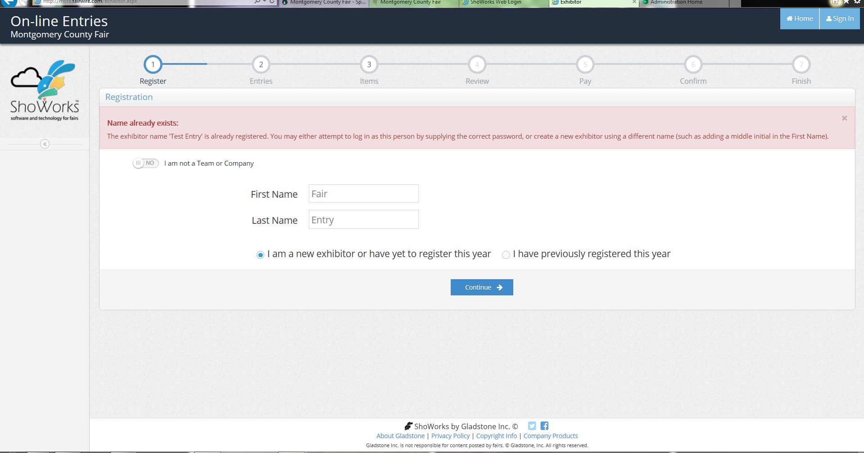
Everyone will enter as a new exhibitor this year.

Slide 5
Complete all required information. Quality Counts is required for all Livestock Projects

Slide 6
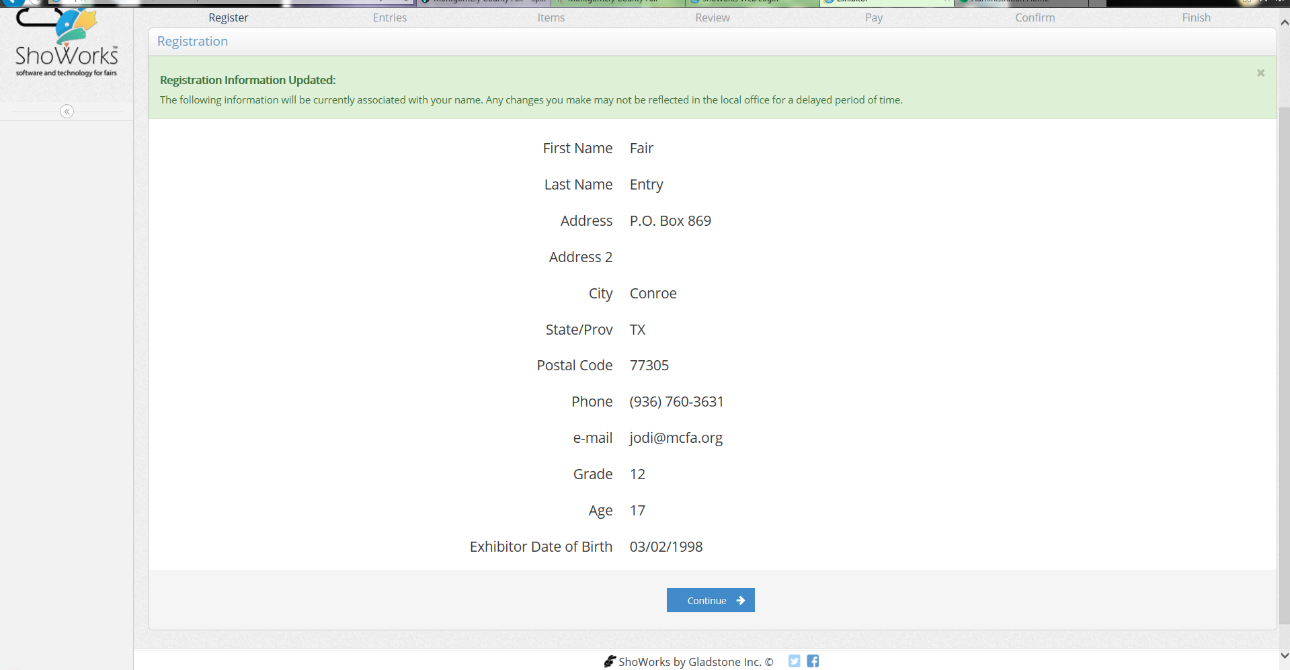
This page has you confirm all information is correct.

Slide 7
For all Homemaking entries, you will be required to upload recipes. For Breeding Beef entries, you will be required to upload registration papers.
This page is where you
will enter in the divisions
you plan to show in.
Fill in all required
Information.

Slide 8
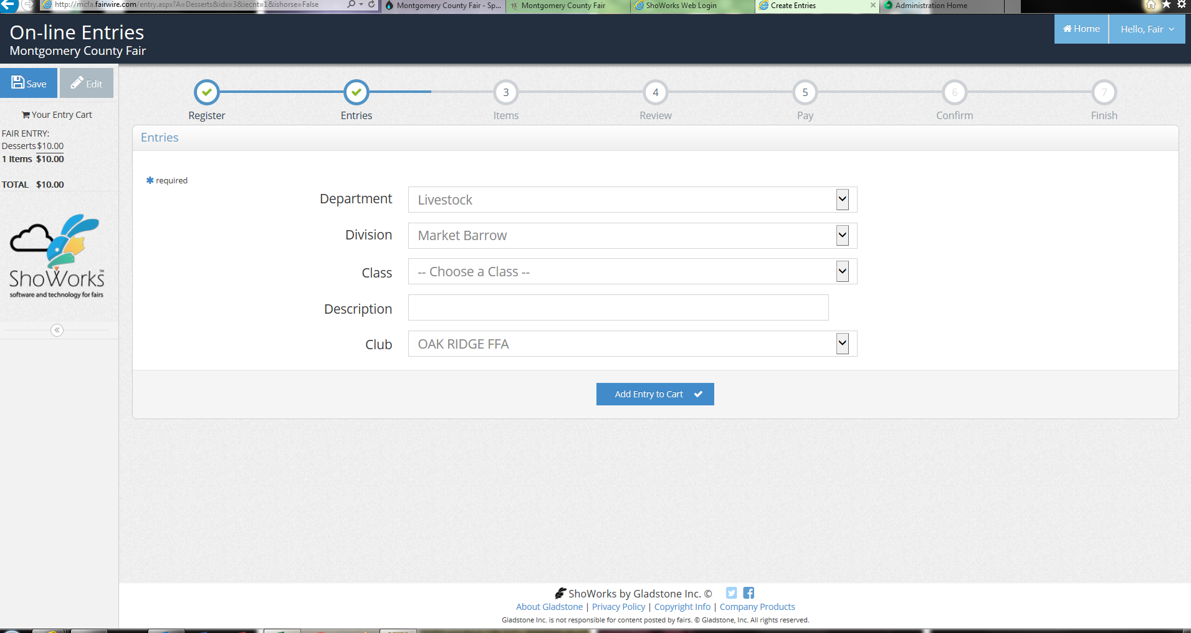
When you enter each entry this is where you will designate what 4-H/FFA group you plan to show under. This is helpful for those that different projects under different groups.

Slide 9
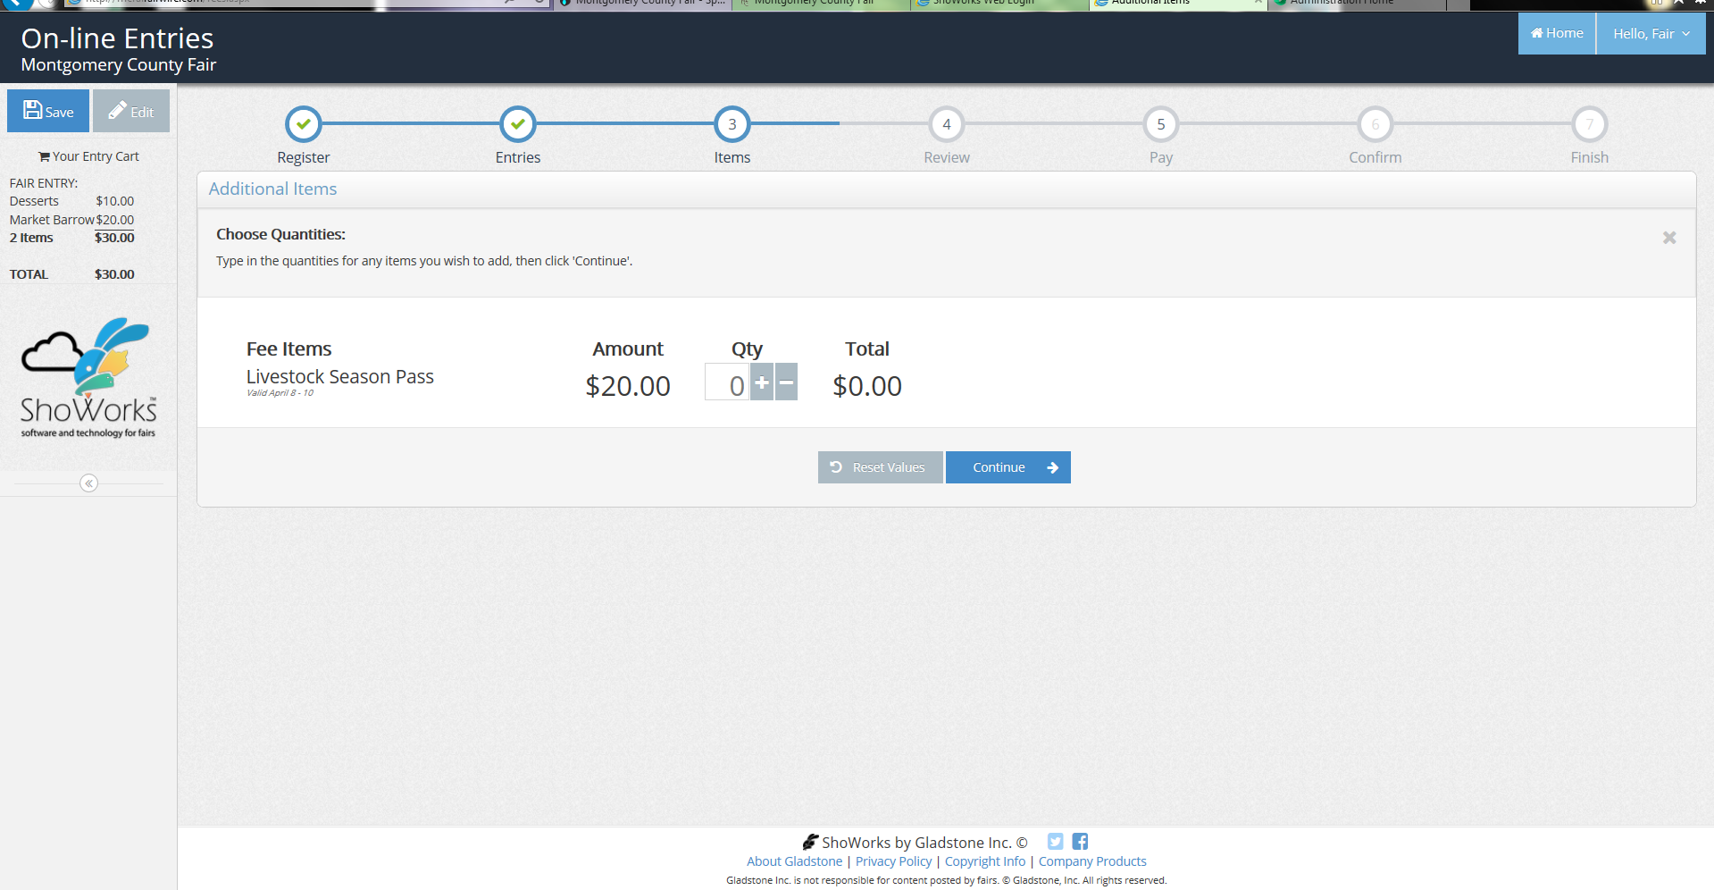
Livestock Season Passes are for family members. One Season Pass will only allow
one family member entry to the Fairgrounds from April 8, 2016 – April 10, 2016.

Slide 10
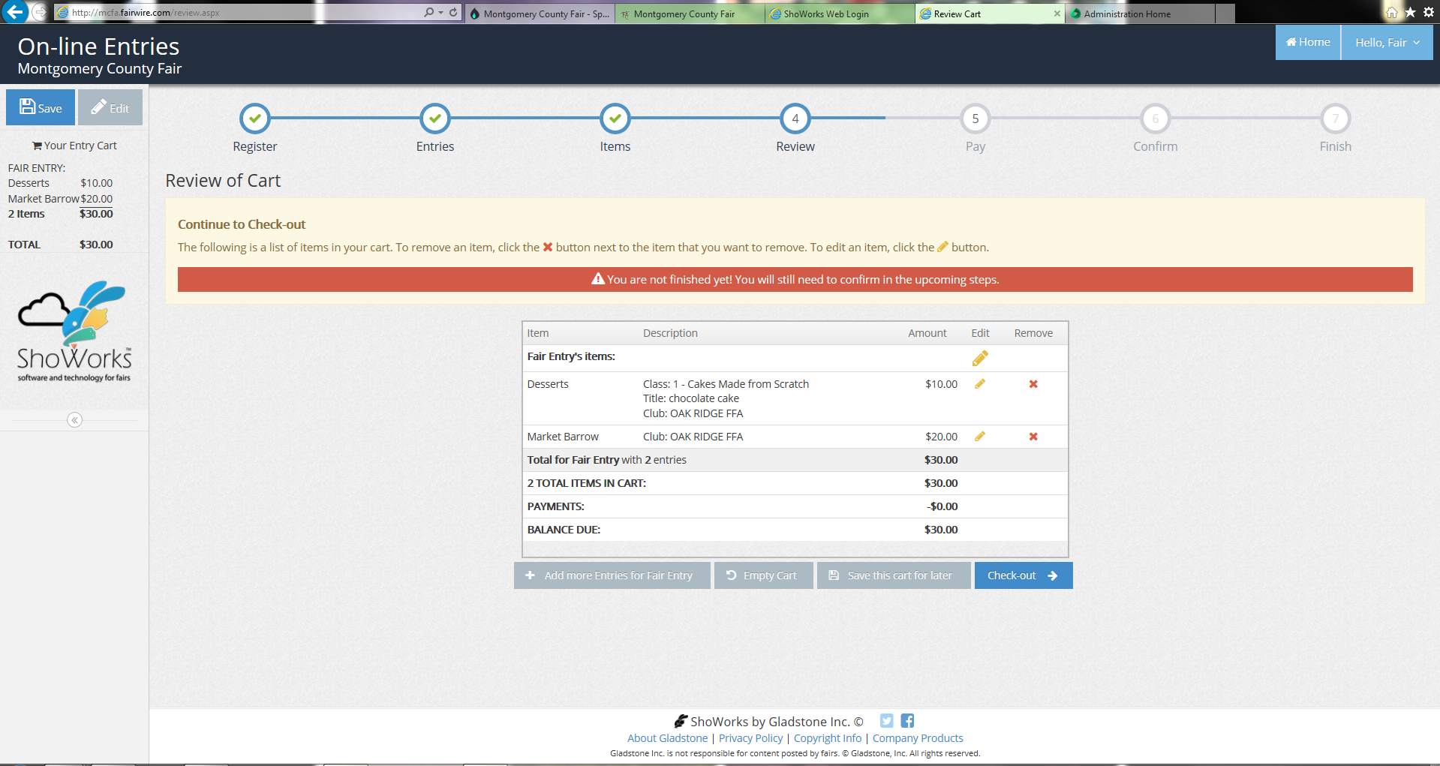

Slide 11
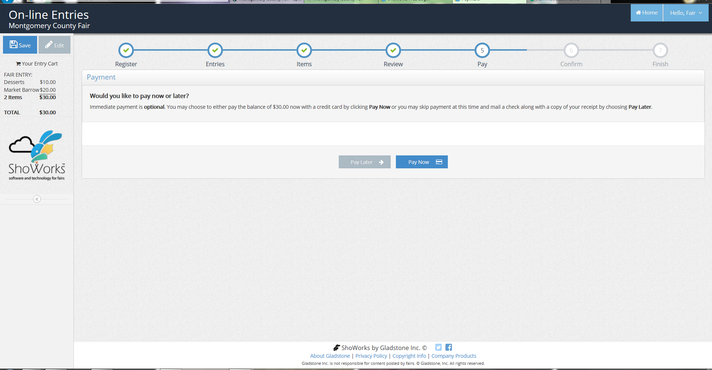
This year, entry fees can be paid online with a credit card or you can bring cash or a check to the office. It is recommended if you plan to pay in the office bring a copy of the receipt to match your fees to your account.

Slide 12
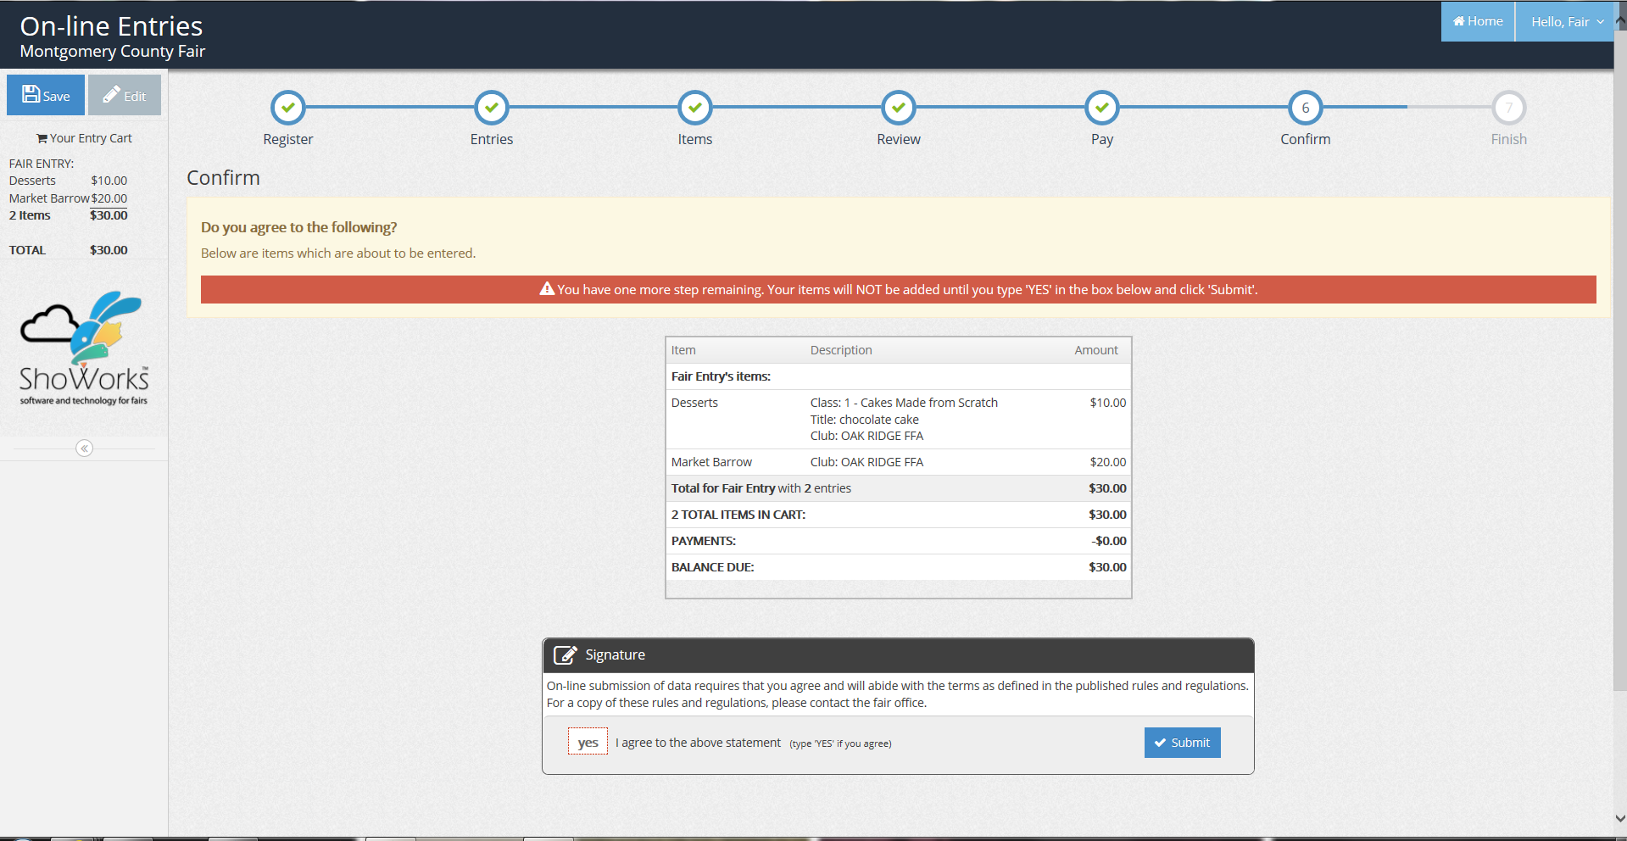
You must type “YES” to
Approve your order.

Slide 13
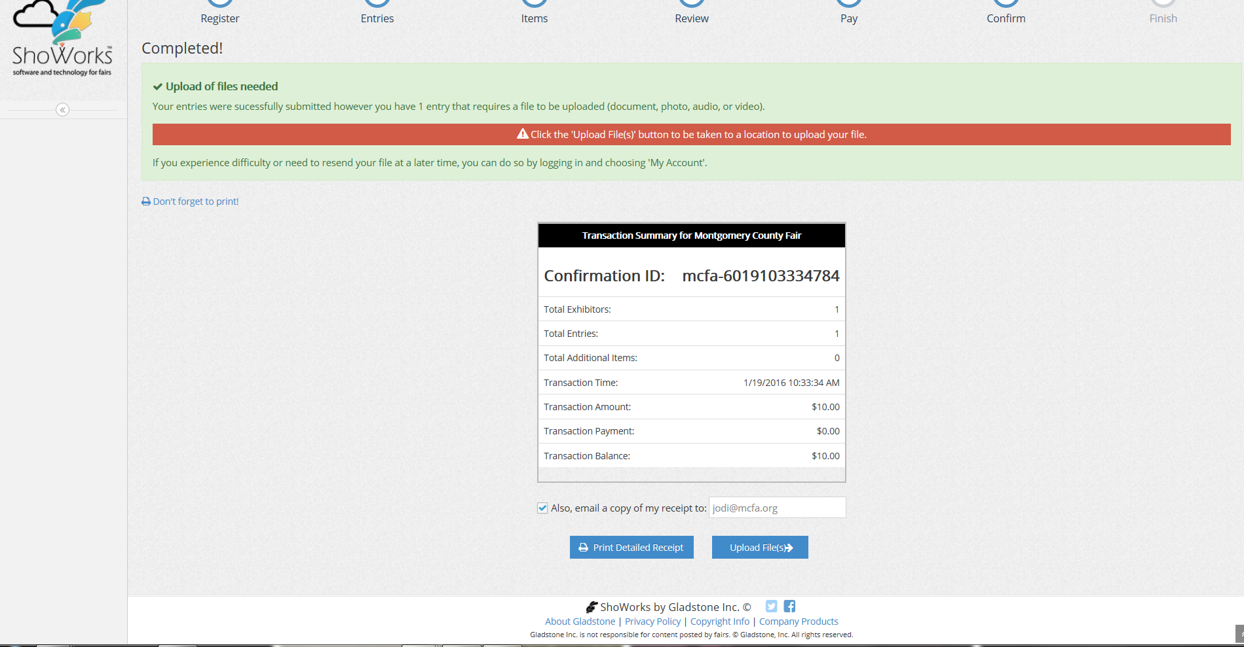
At the top of the screen is a reminder of the files needed to be uploaded.
This is the page where you upload your recipes or registration papers

Slide 14
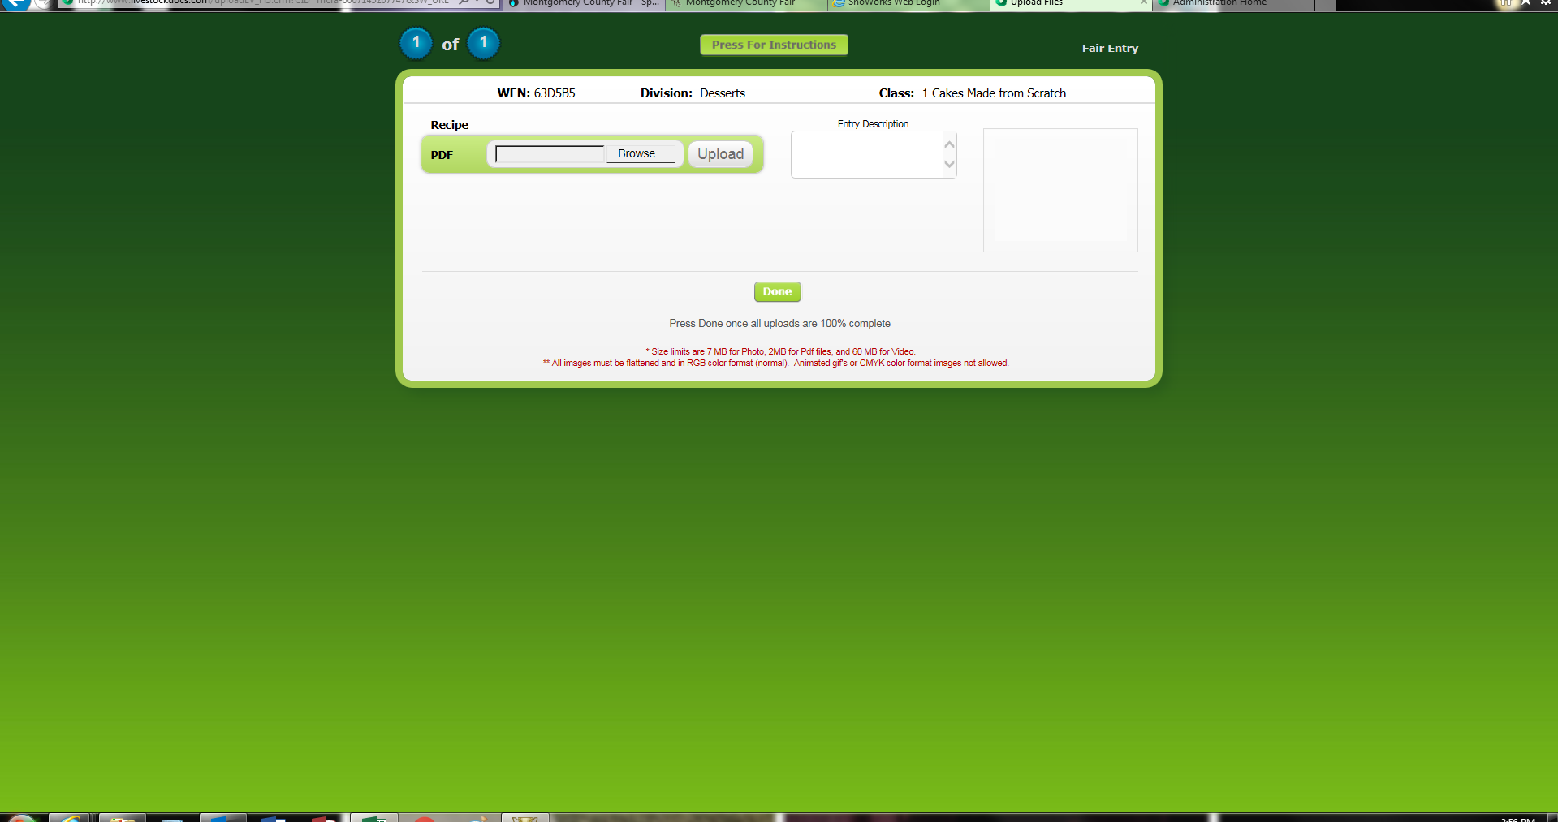
This is where you will upload your recipe or registration papers. A Word Document or PDF can be uploaded.

Slide 15
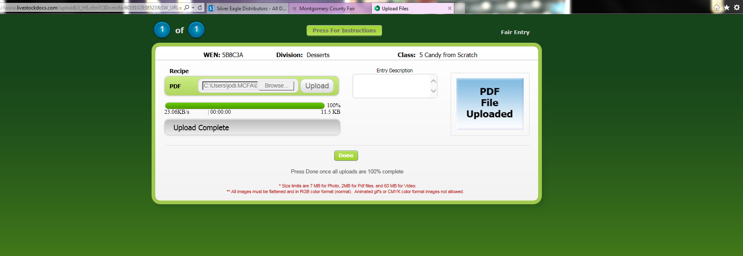
This box will appear when your file has been uploaded.

Slide 16
Entries must be completed and paid for by 5PM on Friday, February, 26, 2016. Recipes and registration papers MUST be uploaded by Friday, February, 26, 2016 also.
It is highly recommended entries are completed sooner rather than later to avoid internet or server concerns.
Teachers/Leaders will pick up packets with wrist bands, Livestock Season Passes and Drug Forms the week of March 7, 2016 – March 11, 2016.
Drug forms and Indemnity forms can be picked up from the Fair Office if you need them sooner.

Slide 17
For questions about the online entry process please contact Jodi Willard at 936-760-3631 or Jodi@mcfa.org

